Slide 1

Writing Great Proposals for Government
Understanding EOI Rules &
Tools for Service Providers
ALIGN MEMBERS
December 17 & 19, 2019
Developed and delivered by
Three E Training Inc.
Edmonton, Alberta
www.3etraining.ca

Slide 2

Learning Outcomes for this Workshop
Introductions
Procurement Rules and Tools
How to Write a Great Proposal for Government

Slide 3

Timeline for today
Module 1 – Rules and Tools
Start 9:00 am
Coffee 10:15-10:30 am
Lunch 12:00-1:00 pm
Module 2 – How to Write a Winning Proposal
Start 1:00 pm
Coffee 2:30-2:45 pm
End 4:00 pm

Slide 4
Kara Thompson, BA, LLB
Allow me to introduce myself…
14 years as procurement lawyer, for Alberta Justice in Children’s and Youth Services, Human Services
  Procurement of different types of children, youth and families services eg. child intervention, disabilities, employment
    last 5 years consulting/lawyering and training for public bodies and private sector procurement

Slide 5

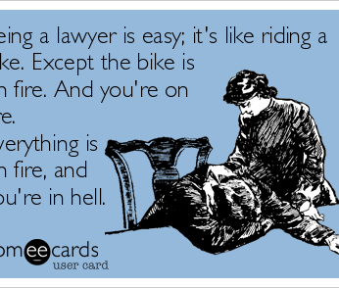


Kara Thompson, BA, LLB

Slide 6

Introductions
Please introduce yourself!
Name
Organization
Hub/Spoke or Hub or Spoke?

Slide 7

Today its all about you!
PLEASE ASK QUESTIONS

Slide 8

Todays Purpose:
Giving you information, and getting you comfortable with preparing a proposal for the EOI

Slide 9

AGENDA
Writing Great Proposals for Government
Introductions
Rules
Procurement rules and policy
Government’s new policy direction
Update from Children’s Services
Tools
d. Procurement tools
RFP v. EOI
Inputs/Outputs/Outcomes
e. EOI Submission Requirements
f. EOI Evaluation Requirements
g. EOI Negotiations
h. Other Considerations
Collaboration Letters, Q&A, Conflicts of Interest, Debriefing

Slide 10
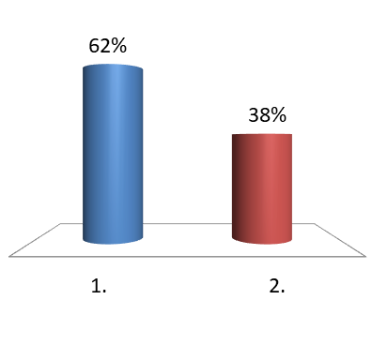
Practice voting…
What is your opinion?
I am already very excited about Christmas!
True
False

Slide 11
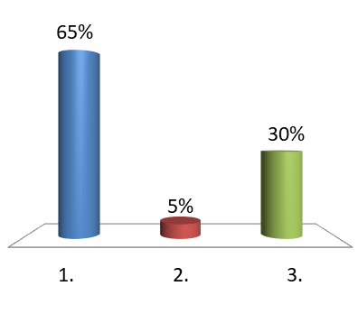
Practice voting…
What is your opinion?
The room temperature is…..
Perfect for optimal learning
Too hot
Too cold

Slide 12
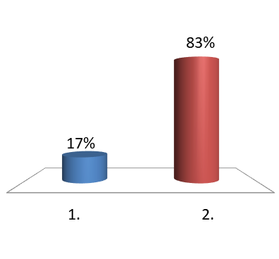
Practice voting…
What is your opinion?
I love applying for funding through new government processes!
True
False

Slide 13
Procurement Rules
Why should I care about procurement rules if this is a GRANT?
Because the Expression of Interest issued by Children’s Services, which is a grant application process, resembles a traditional procurement process
So you will want to prepare yourself to respond to the EOI with a grant proposal that is more like an RFP proposal

Slide 14

Procurement Rules
Why does government have to do it?
BASIC PRINCIPLES OF:
FAIRNESS
OPENESS
TRANSPARENCY
Accountability for public dollars spent.

Slide 15
Procurement Rules
Why does government have to do it?
FAIRNESS, OPENESS, TRANSPARENCY
1. Common Law of Procurement and Contract
2. Trade Agreements (eg. CFTA, TILMA, NWPTA, etc)
3. Government:
Legislation (law) - mandatory
Regulations - mandatory
Government-wide Procurement Policy – mandatory
Children’s Services specific policies – should be followed (but some discretion)

Slide 16

Trade Agreement Thresholds
2007, Trade, Investment, Labour and Mobility Agreement - TILMA (AB & BC)
2017, Canadian Free Trade Agreement
2010, New West Partnership Trade Agreement - NWPTA (Alberta, BC, SK)
Procurement rules of the NWPTA apply to British Columbia, Alberta and Saskatchewan:
(a) departments, ministries, agencies, boards, councils, committees and commissions where the anticipated costs are:
$10,000 or greater for goods
$75,000 or greater for services
$100,000 or greater for construction

Slide 17
Procurement Policy
Why does government have to do it?
FAIRNESS, OPENESS, TRANSPARENCY
The outcomes of any procurement of goods, services or construction are to:
meet business needs and objectives for each Ministry
ensure equal and fair access to government procurements is provided to qualified vendors, suppliers and contractors
demonstrate best value to the government for each procurement
produce appropriate documentation
meet legislative, policy, and trade agreement requirements
From: http://www.servicealberta.gov.ab.ca/bid-on-opportunities.cfm

Slide 18
Procurement Policy
Children’s Services
Procurement and Contract Resources
Preamble to Expression of Interest (EOI) for Family Resource Networks (FRN’s), p.3
“ …to ensure the acquisition of services is completed through a fair and transparent process guided by the Alberta Government’s Procurement and Sole-Sourcing Directive, and with trade agreement obligations.”
“The Procurement Accountability Framework reinforces fairness, transparency and integrity in the EOI process; adds rigour and accountability to Ministry process; drives consistency and reinforces a set of shared values and ethics.”

Slide 19
Procurement Policy
Children’s Services
Procurement and Contract Resources
“To ensure alignment with the Treasury Board Procurement and Sole Sourcing Directive [nothing can be sole-sourced over $10K], CS will issue grants for FRN services through an EOI process.” p.3
For Service Alberta resources, including procurement formats and terms and conditions:
http://vendor.purchasingconnection.ca/

Slide 20

Children’s Services
New Direction for 2020
CS is moving to change from spending $77 million on early intervention and prevention annually to $55 million annually
Increase accountability
Align services
Reduce spending

Slide 21
Children’s Services “Retooling” Direction
Direction from executive in November 2019
open “competition” for granting process through EOI
evidence-based service delivery requirements
new requirement for prevention services from 0-18 years, instead of previous 0-6 years

Slide 22
Children’s Services “Retooling” Direction
Children’s Services is moving from a “patchwork” of services, to a more streamlined system where services are continuous (0-6, then 7-18) and seamless (aligned service providers)
Age Cohort Program and Service Distribution in EOI:
0-6 years 50-60% programming
7-13 years 20-30% programming
14+ years 20-30% programming

Slide 23
Children’s Services “Retooling” Direction
FROM THE HORSES MOUTH:
OUTCOMES-BASED
How will results be measured?
DIVERSITY LENS
Need to be inclusive (e.g. LGBTQ+, Indigenous, ethno-cultural)
UNIVERSALLY ACCESSIBLE
0-18 years for prevention and early intervention – identify this gap in services!

Slide 24
Children’s Services “Retooling” Direction
PRACTICES STANDARDS
Being developed by CS, and CS will be developing its own training
REALISTIC BUDGETS
Make sure your budget reflect your realistic costs
FOCUS ON WHAT QUALIFICATIONS STAFF HAS
e.g. What training has your staff taken that qualifies them to do this service?
TRAINING WILL BE DEVELOPED BY CS
- Don’t focus on training you can develop

Slide 25
Children’s Services “Retooling” Direction
Universal
  Available to ALL infants, children, youth (0-18 years) and families
Targeted
  Designed to meet needs of vulnerable infants, youth and family who have risk factors associated with increased risk of child maltreatment
Intensive services
  Specific to needs of infants, children, youth and families who are experience significant adversity

Slide 26
Children’s Services “Retooling” Direction
ACCOUNTABLE
Knowing exactly what EI/prevention services they are purchasing
measuring the dollars spent on types of services
measuring the types of clients/services served
measuring the outcomes of those dollars spent
Using performance and accountability MEASUREMENTS with grants

Slide 27
Children’s Services “Retooling” Direction
UNIVERSAL
Knowing exactly who (eg. Hubs and Spokes agencies) are providing specific types of EI/prevention for what regions/clients
measuring how many different types of services
measuring the types of clients served
  Aboriginal and Metis
  Francophone
  New Canadians/Immigrants
  Other Ethno-cultural groups
measuring the outcomes for those specific clients

Slide 28
Children’s Services “Retooling” Direction - Practice
In March 2019, Children’s Services released the
Well-being and Resiliency: A Framework for Supporting Safe and Healthy Children and Families
CS will use as a guide in promoting a consistent province-wide approach for prevention and early intervention services and supports

Slide 29
Children’s Services “Retooling” Direction
What does that mean for you?
Be able to show in your proposal
  Who you serve (e.g. types of clients)
  Demonstrate all the ways in which you serve them (e.g. your specialized and unique services)
  What are the demonstrable ways that you achieved outcomes? (e.g. what types of measuring tools do you currently use?)

Slide 30
Children's Services
Procurement Options
Open Procurement (RFP)
Limited Procurement(PQR)
Sole-Source

Slide 31

Procurement Terminology
Common Procurement Tools
Request for Proposal (RFP)
Request for: Expression of Interest (EOI)
Notes:
Focus will be on RFPs
Emphasize the nomenclature is not universal…don’t assume based on the title…read closer to determine intent of the procurement
Describe the intent of each tool

Slide 32
Common Procurement Tools
Expression of Interest
Purpose: To determine the market interest in a competitive solicitation process (i.e. how many vendors would be interested in competing on the opportunity).
Used when: The EOI is a market research tool that helps to plan for the solicitation process. There will be no evaluation, ranking, or selection of vendors as a result and it will not be used to pre-qualify or screen vendors for a subsequent competitive bidding process.

Slide 33
Expression of Interest (EOI)
Grant application
WHY IS THIS UNUSUAL? Because…
EOI’s are usually NOT used to award any type of contract or grant
Grants are being awarded under the terms of this EOI
A grant is legally NOT the same as a contract

Slide 34
Expression of Interest (EOI)
Grant application
Is normally only a “market research tool”
Not normally used to evaluate, rank, or select vendors, or used to pre-qualify or screen vendors for a subsequent competitive bidding process
In this particular process it is being used as a grant application process
However, this grant application process mirrors the submission process for an RFP proposal
THEREFORE…. Discuss applying for grants under this particular EOI, as mirroring an RFP submission process
  Criteria in the EOI, similar to mandatory/desirable criteria in an RFP

Slide 35
Contracts and Grants
What’s the difference?
Contract
Grant
Core services
Provides essential services for clients of government
Funds paid to service provider in exchange for services performed
Accountability for units of services delivered (eg. deliverables) for $
SUBJECT TO ALL GOA PROCUREMENT POLICIES AND $ LIMITS, AND TRADE AGREEMENT OBLIGATIONS
Non-core services, but under general Ministry mandate
Often helps other organization achieve its mandate
Funds given on conditions, which must be reported on
Accountability for fulfilling grant terms
OUTSIDE OF PROCUREMENT PROCESS
*Usually requires application to GOA

Slide 36
Expression of Interest (EOI)
Grant application
GRANTS and the awarding of grants
Grants are not subject to procurement rules
mandatory requirements not as strict, CS can use discretion when accepting proposals that don’t comply
  but will have to satisfy grant application terms to be accepted
usually high score is 100% binding
  highest score isn’t basis for grant award as per wording in EOI Grant awarding will be determined based on Proponent achieving a minimum score of 3.5 on each relevant section, quality of responses as well as other key considerations

Slide 37
Expression of Interest (EOI)
THEREFORE for the purpose of this workshop ONLY, we will be treating:
Expression of Interest = similar to = Request for Proposal
EOI Proposal = similar to = RFP proposal
Grant = similar to = contract awarded under an RFP
BUT… they are NOT the same.
- Only use this analogy to ensure you have everything you need in your grant agreement

Slide 38
Common Procurement Tools
Request for Proposal (RFP)
Competitive and collaborative procurement
Seeks innovation and creativity
Most sophisticated procurement for both parties
Price is only part of it

Slide 39
Common Procurement Tools
Request for Proposal (RFP)
Terms and Conditions (and definitions)
  For the procurement and the contract
Desired outcomes and solution that the government is seeking to purchase
Evaluation criteria: Mandatories and Desirables
Submission format requirements
Reference materials

Slide 40
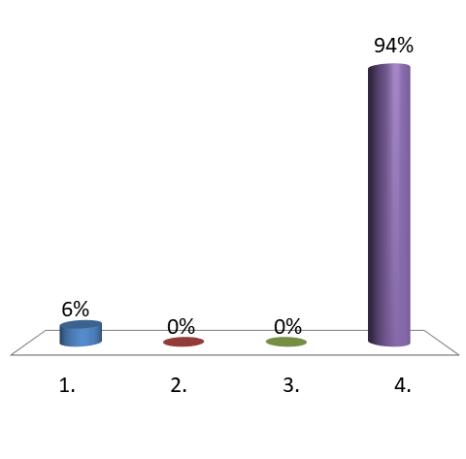
Which of the following are part of the objectives of this EOI (page 8 of EOI)?
Establish approach that respects and reflects culture, language and spirituality of people served
Formalize commitment to development and embedding of output and outcome monitoring and reporting process
Develop collaborative and cooperative referral pathways with CI system to prevent need for CI services
All of the above

Slide 41
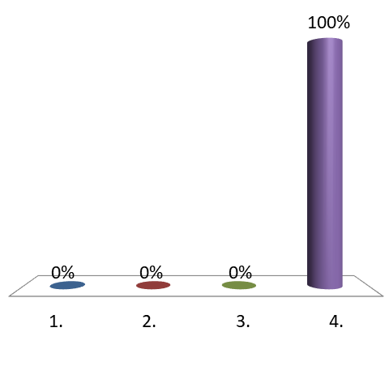
How many objectives of this EOI (page 8) are there?
FIVE
SEVEN
EIGHT
NINE

Slide 42

Exercise - New Model
You will see Hub and Spoke icons on the wall
Place yourself in the appropriate group
3. All Spokes go to the Hub group and introduce yourself to 3 people
Notes:
Make half the room Hubs and half the room Spokes

Slide 43

Outcomes
Process/ Activities
Inputs
Outputs/
Deliverables
Evidence and
Outcome-Based
Service Delivery

Slide 44
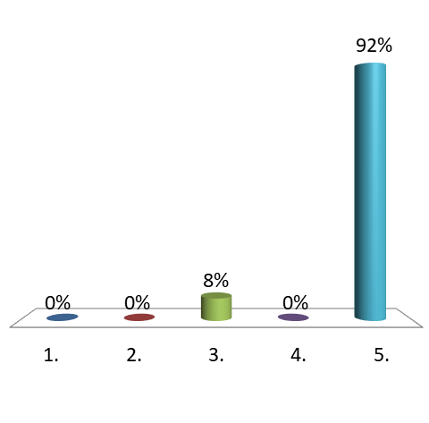
Examples of inputs are…
If a region is S, M or L
How many immigrant clients are in a region
Estimated funding for each region
Number of 0-6 years clients in each region
All of the above

Slide 45
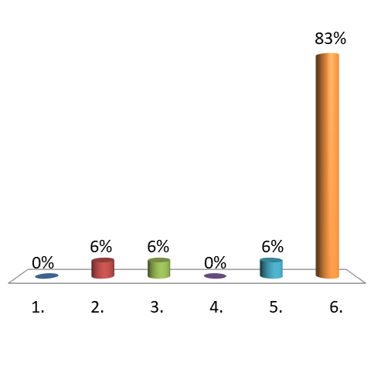
My organization offers programs/services in…
Early intervention sector
Prevention
Early childhood development
Community-based prevention
Community capacity building services
All of the above

Slide 46
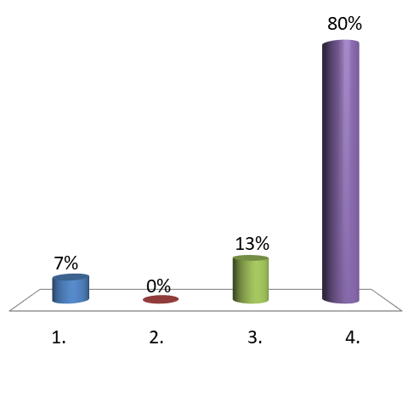
Examples of outputs (deliverables) are…
How many clients my organization has served in a month
Dollars my organization spent on a part-time worker
How many sessions were offered per week
All of the above

Slide 47
Results Specifications
Outcomes
Impact
Outputs
Quality & Quantity of Deliverables
47

Slide 48
Outputs vs. Outcomes
Traditional service contract
Outcome-based services
Based on outputs/ deliverables (eg. units of service, etc.)
What units of service have been delivered over the course of the grant?
Examples:
Number of children and families that were served in a month
Based on what outcomes have been achieved over the course of the contract
What behaviour has been influenced or changed by the provision of the services?
Examples:
Caregivers were able to improve their knowledge of aboriginal cultural practices relating to children

Slide 49
CHILDREN’S SERVICES – BUSINESS PLAN
OUTCOMES
IN CS BUSINESS PLAN 2019-2022
KEY STRATEGIES AND
PERFORMANCE MEASURES

Slide 50
CHILDREN’S SERVICES – BUSINESS PLAN
OUTCOMES, KEY STRATEGIES AND
PERFORMANCE MEASURES
Outcome One: Children Thrive – Children and youth are protected
Key Strategies:
1.2 Support children in care to develop long-term, nurturing relationships by increasing the connections to family, significant persons and Indigenous communities.

Slide 51
CHILDREN’S SERVICES – BUSINESS PLAN
OUTCOMES, KEY STRATEGIES AND
PERFORMANCE MEASURES
Outcome Three: The well-being resiliency and cultural connections of children, youth and families is nurtured and enhanced
…
  3.1 Develop strategies to support safe, healthy and resilient children and families, including mentorship opportunities for children and youth who have experienced trauma
  3.3 Support child safety and enhance parenting skills and knowledge by supporting families and caregivers in their home environment.

Slide 52
CHILDREN’S SERVICES – BUSINESS PLAN
OUTCOMES, KEY STRATEGIES AND
PERFORMANCE MEASURES
Outcome Three: The well-being resiliency and cultural connections of children, youth and families is nurtured and enhanced
…
  3.4 Collaborate with Indigenous communities, leaders and partners to strengthen relationships and develop strategies to support Indigenous children, youth and families while ensuring all staff and service delivery partners have enhanced Indigenous cultural awareness.

Slide 53
Exercise - Outcomes
At your tables, identify ONE service your organization offers.
2. What can you say about that service to demonstrate it actually influenced one of the Children’s Services outcomes (as set out in their CS Business Plan)?
3. Discuss with neighbor.
Notes:
Make half the room Hubs and half the room Spokes

Slide 54
Your Proposal - Emphasize Outcomes! OUTCOMES, KEY STRATEGIES AND
PERFORMANCE MEASURES
State the outcomes you will seek to influence and how they align with the procurer’s strategic priorities and larger desired outcomes
How desired outcomes align with your vision/mission/principles/values
How you will measure outcomes
How you will deliver services
Risks and uncertainties and how you will manage and mitigate them

Slide 55

Children's Services
EOI Submission Process
What do you need to submit?
What format does it need to be in?

Slide 56
Children's Services
EOI Submission Process
PAY ATTENTION TO ALL THE MANDATORY REQUIREMENTS FOR SUBMISSION! Page26, section 7.1
PROPOSAL SUBMISSION INSTRUCTIONS, page 27, section 8.2
All of the documents required:
Proponent Cover Page, Proponent Commitment Statement, Proponent Response Form, formal letters of support from collaborative partners
REQUIREMENTS, page 34, section 11.3

Slide 57
Children's Services
EOI Submission Process
MULTIPLE SUBMISSIONS FOR MULTIPLE LOCATIONS
CLOSING DATE AND TIME
Must be submitted by Jan.20, 2020 no later than 2:00:00 pm
TERM OF GRANT
- 3 years, from 2020-2023

Slide 58
Children's Services
EOI Submission Process
BUDGET
Pay attention to budget allocation, p.25
Submit in the correct format
Put expenses in correct expenditure categories, p.30
    Really know the rationale behind your
budget numbers. You will have to
justify them during negotiations and
must know what your bottom lines are.

Slide 59

Children's Services
EOI Submission Process
BUDGET
Use standardized format
Explicitly relate your price to
what is being proposed
Align funding with amount of services required
Ensure you will have to have the capacity to deliver within the budget you propose
Be thinking about the negotiation as the
next step

Slide 60

Children's Services
New EOI Evaluation Process
What is being evaluated in this new EOI process?
How is it being evaluated?

Slide 61
Children's Services
New EOI Evaluation Process
New EOI grant award processes
Phase 3 – Proposal Evaluation – The…Evaluation Teams will initially evaluate proposals based on criteria identified in Section 10… proposals will be reviewed in the following order:
First evaluation of “all-inclusive FRN proposals, where a proponent is proposing to deliver both “Hub” and a full range of “Spoke” services, then
Evaluate distinct “hub” service proposals, and finally,
Evaluate separate and distinct “Spoke” services…

Slide 62
Children's Services
New EOI Evaluation Process
Because of this, it is in probably in your best interests to survey any Hub organizations in your area, to determine if you:
May wish to form a partnership as your proposal may be evaluated more favourably if you are in already in partnership with a Hub,
To survey which partnerships it is likely that CS may put you into

Slide 63
Children's Services
New EOI Evaluation Process
Phase 4 – Identify Qualified Proponents
“Qualified proponents will be identified based on a proposal achieving a minimum requirement, as identified in the evaluation section of this EOI. During this phase, collaborative and partnership opportunities will be identified and provincial coverages will be assessed.”

Slide 64
Expression of Interest (EOI)
SCORING
    p.32, section 10.4
    “Grant awarding is not based on achieving the highest score. Grant awarding will be determined based on Proponent achieving a minimum score of 3.5 on each relevant section, quality of responses as well as other key considerations including:
    Appropriate distribution of FRNs for indigenous and other cultural identities
    Capacity of FRNs to provide continuum of 0-18 years
    Accessible and reasonably distributed services across province
    Services are adequately resourced to meet community need
    Addressing rural and urban needs
    Matching services to unique community needs
    Proponent submitted budgets

Slide 65
Expression of Interest (EOI)
SCORING
Part A – Scope info
organizational profile 3. /6 pts
community needs assessment 4. /6 pts
Collaborative partnerships 5. /6 pts
Part B – Hub Services
Address 1. /6 pts
Hub 10 responsibilities 2. /6 pts
Hub approach 3. /6 pts
Hub performance/outcome measureme 4. /6 pts
Hub budget 5. /6 pts
Hub additional info 6. /6 pts

Slide 66
Expression of Interest (EOI)
SCORING … continued
Part B – Spoke Services
Spoke Services 1. /6 pts
Spoke Services Implementation 2. /6 pts
Spoke performance/outcome measurement 3. /6 pts
Spoke budget 4. /6 pts
Spoke additional info 5. /6 pts
You must score a minimum of 3.5 in each section.
“Grant awarding will be determined based on Proponent achieving a minimum score of 3.5 on each relevant section, quality of responses as well as other key considerations…” (p.32)

Slide 67
Evaluation Criteria
Mandatories:
Musts
Not scored - met or not met
If not met, proposal may be rejected
Desirables:
  Wants
  Proposed Deliverables
  How will services be delivered?
  How are outcomes aligned and measured?
  Innovation and creativity?
  Weighted and Scored

Slide 68
Evaluation Criteria
What’s the difference?
Mandatories
Desirables
Always yes or no
Very few
Completely objective
Not scored
Gating mechanism to ensure compliant proposals
Either met or not met
  If ALL mandatories not met, then proposal MAY BE rejected at the start of the scoring process
In the gray area
Many
Subjective
Scored against scoring rubric (highest scoring proposal is the successful bidder)
All of the aspects that are being wished for on the project
May have some desirables but don’t need to have all

Slide 69

Evaluation Criteria
Mandatory and Desirable Criteria
MANDATORY
Administrative – procurement process (eg. three copies, signed submission document, etc.)
DESIRABLES
Proponent Experience/Capacity/Resources
Proposed Solution: Results and Risks, influence on Outcomes
Budget: Total and “realistic” costs

Slide 70
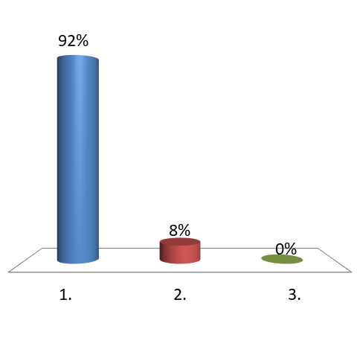
For my proposal to qualify, I need to focus on the achieving minimum scores (3.5/6) in each relevant section
True
False
Minimums don’t count because its not an RFP proposal

Slide 71
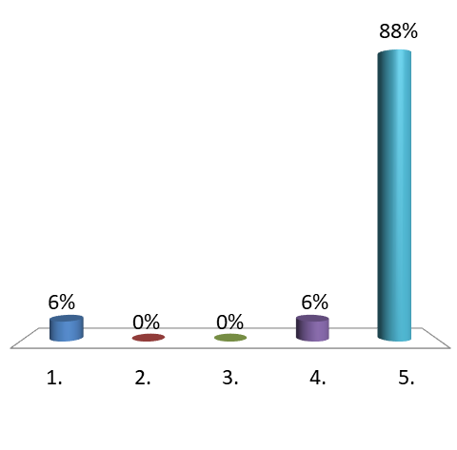
Which are mandatory criteria in this EOI?
Must be submitted Jan. 20, 2020 no later than 2:00 pm
Must be submitted in a sealed envelope and clearly marked with name of EOI and closing date
Must be completed cover page and signed by organization
Must have three formal letter from collaborative partners
All of the above

Slide 72
Evaluation Criteria
Desirable Criteria
DESIRABLES
Proponent Experience/Capacity/Resources
Proposed Solution: Results and Risks, influence on Outcomes
Budget: Total and “realistic” costs

Slide 73
Evaluation Criteria
Desirable Criteria
On page 10, Section 3: Service Specifications (desirable criteria) it states what your organization is expected to set out in its proposal.
Be prepared to show:
How? (eg which tools do you use) to show
your outcome and performance measures.

Slide 74
Evaluation Criteria
Responding to
Desirable Criteria
Answer explicitly and in detail
Evidence-based responses/statements
Explain logic models with rationale
Proper terminology
  Ensure you understand the procurer’s terminology
  Avoid dated terminology
  Define any new terminology in your proposal

Slide 75
Evaluation Criteria
Desirable Criteria
Make sure you incorporate all the following into the types services your organization offers:
Core Service Delivery Domains, p.14, section 3.4
FRN Principle-Based Practices, p. 17, section 3.6
Four Program Outcomes at individual and family level, p.20, section 3.8

Slide 76
Outcome and Performance Measurement
To be successful, your grant proposal must line up with the
program outcomes, and the core service delivery domains set out
in the EOI.
You must be able you can measure outcomes and your performance at these levels:
a. Four program outcomes, at the individual
and family level, under
b. Three Core Service Delivery Domains.

Slide 77
Outcome and Performance Measurement
CORE SERVICE DELIVERY DOMAINS p. 14, section 3.4
Child development and well-being (e.g. parent/child development programs, youth leadership programs, etc)
Caregiver capacity building support
  Caregiver education/training/skill building (eg. Triple P Parenting)
  Family Support Services (eg. Home visitation)

Slide 78
Outcome and Performance Measurement
CORE SERVICE DELIVERY DOMAINS… continued p. 14
3. Social connections and support
Social connections and support (eg. Provide opportunities for social support)
Information, referral, and coordination services (eg. Navigating service systems)
Community capacity building (eg. Support community capacity to promote family well-being and resiliency)

Slide 79
Exercise - Outcomes
At your tables, for your targeted client population,
1. Choose one of the 3 Core Service Delivery Domains:
Child development,
Caregiver support,
Social connections, AND
2. How will your organization services demonstrate that it is implementing, embedding and contributing to the Core Service Delivery Domains?

Slide 80
Outcome and Performance Measurement
FRN PRINCIPLE-BASED PRACTICES
All directly delivered and coordinated FRN services MUST
embed the following principle-based practices: (p. 18)
Indigenous Experience
Preserve Family
Strength-based
Connection
Emphasis on early brain development and brain architecture
Positive Youth Development Approach (PYDA)
Collaboration

Slide 81
Outcome and Performance Measurement
FRN PRINCIPLE-BASED PRACTICES
Continued…. p.19
Continuous Improvement
Evidence-based practices
Evidence-informed practices
Practice-based evidence

Slide 82
Outcome and Performance Measurement
FRN PRINCIPLE-BASED PRACTICES
Use the terms set out in section 3.6, pages 17-20, to tie your
Organization’s services to the FRN Principle-Based Practices:
EXAMPLES
“child-focused and family centred”
“evidence-informed practices”
“client, clinical expertise”

Slide 83
Outcome and Performance Measurement
PROGRAM OUTCOMES
FRN’s promote four program outcomes, at the individual
and family level:
Infants, children, youth and families are more socially connected and linked to culturally relevant supports.
Parents and caregivers have knowledge about parenting and child development.
Parents and caregivers are resilient.
Infants, children and youth experience health social and emotional development.

Slide 84
Exercise - Program Outcomes
At your tables, for your targeted client population,
1. Choose one of the four program outcomes, at the individual and family level AND
2. How will your organization services demonstrate that it is implementing, embedding and contributing to the Core Service Delivery Domains?
3. Pick two FRN principles-based practices you could use to show this (p.17, section 3.6)

Slide 85
Outcome and Performance Measurement
PERFORMANCE MEASUREMENT
On p. 21, the EOI asks for:
Standardized performance measurement/assessment tool (e.g. in-depth questionnaire or procedure)
  should be specific, sensitive, reliable and valid
2. Programs supporting Indigenous communities, families, children and youth should implement culturally-based practices and assess outcomes and program effectiveness in culturally meaningful ways (e.g. Indigenous methods and practises of wisdom-seeking, for example Well-being and Resiliency: the miyo resource
EXAMPLES? HAVE YOU USED STANDARDIZED TOOLS OR CULTURTALLY-
BASED ASSESSMENTS?

Slide 86
Outcome and Performance Measurement
S M A R T MEASUREMENT
“FRNs must demonstrate… results and outcomes.”
Make sure all of your results and outcomes can be demonstrated!
S – specific
M – measurable
A – accurate
R – relevant
T – timely/tangible

Slide 87
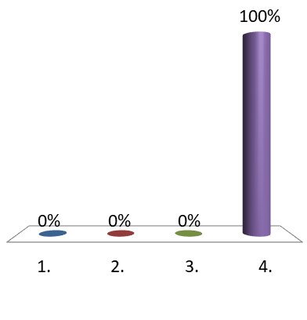
Which of the following is a SMART measurement?
27 youth attended 2 sessions of youth leadership group
Ten families were served in the 8 weeks of the program
55 immigrants saw the counsellor in a 2 year span
All of the above

Slide 88
Exercise - Services Implementation
1. Think about your organization’s services, and how it can demonstrate that it is implementing, embedding and contributing to the:
Prevention and Early Intervention Continuum (Universal/Targeted/Intensive) and the
Program distribution for age cohorts
0 - 6 years - 50-60%
7-13 years - 20-30%
14 + years - 20-30%
2. Turn to your left, and share with your neighbor how you think your organization is able to do this.

Slide 89
Three Letters of
Collaborative Support
The Service Provider must provide a minimum of
three letters of support from collaborative partners
in the region where services are to be offered.

Slide 90

NEGOTIATIONS:
How does the negotiation process work for these grants?

Slide 91

Children's Services
Negotiation Process
“Phase 5 – Service and Program Development and Negotiation
– Family and Community Resiliency Division, Regional personnel, Regional Contract Teams, and qualified proponents will negotiate and formalize partnerships and collaborations, funding allocation, program components, responsibilities and expectations for the successful implementation of FRNs. Negotiations will involve determining formal collaborations and partnerships to ensure the FRNs have the capacity to deliver a full continuum of prevention and early intervention services…”

Slide 92
Children's Services
Negotiation Process
Reporting Requirements
Output and Outcome Requirements – p.22
Make sure you know what kind of reporting requirements are expected, when you are expected to provide them and in what format.

Slide 93
Negotiating the Contract
Determine if expectations are still the same, or if some areas need to be re-adjusted
Resolve outstanding issues
Mutual agreement on risks and mitigations
Make sure what was asked for in the proposal, matches what is being asked for in the contract you are signing

Slide 94
Negotiating the Contract
RISKS
  Are there risks already identified in the EOI?
  Are there risks that you are aware of by virtue of your expertise?
    Budget? (eg. Staff retention if underfunded)
    To clients? (eg. Won’t be able to access services)
    To you or other organizations?
  Mitigating and managing risk
    What do you propose?

Slide 95

Before signing the grant agreement ….
- Reporting requirements
- Monitoring activities
- Evaluation plans
- Identify all deliverables :
* Units purchased
* Cost per unit
Service Provider should be a legal entity
- Term of contract versus date signed
- Total contract value
- Key contacts
- If required, changes to boilerplate terms and conditions
- Process/activity requirements

Slide 96
Negotiating the Contract
Negotiation is a slight adjustment to the contract… should not be major changes to services.
Make sure you capture all changes to your original proposal in writing!

Slide 97
Exercise - Identifying Risk
At your tables, for your targeted client population,
1. What is one risk (vulnerability) of this community that you can identify?
2. How can your organization assist with that risk (vulnerability) and manage or mitigate that risk?

Slide 98

OTHER CONSIDERATIONS:
Other things you need to think about

Slide 99
Service provider
Q & A sessions
***IMPORTANT***
If you have further questions must send to EOI facilitator at least three days before EOI closing
Read all the Q&A’s for updated information, and more detailed explanations
Updated once per week, see p. 36, section 11.7
  Dec.20, Jan.3, 10, 15, 2020

Slide 100
Service provider
Q & A sessions
All questions regarding EOI were sent prior to Q & A sessions
All questions asked were recorded, and all answers were written and sent out to attendees at the Q & A

Slide 101
Other Service Provider Considerations
Awareness of being a lobbyist (Lobby Act)
Confidential dealings with government
Intellectual Property Ownership
Awareness of Conflict of Interests – real or perceived

Slide 102
Awareness of Conflict of
Interest Guidelines
No preferential treatment, fair and open for all service providers
  E.g. no family member/spousal type relationships
Government is to be unbiased and objective
No disclosure of confidential service provider or government or client information
Service providers must disclose any conflicts that they are aware of (including possible “perceived conflicts”)
Notes:
NOTES

Slide 103
Debriefing Process
If you are not awarded a grant, you are entitled to a debriefing process.
  Must be offered in a timely manner after awards granted
  Must tell you which sections of your proposal were weaker/stronger
  Cannot tell you if you were first, second, third,
  Will be restricted to following their process
    Was it fair? Open? Transparent?

Slide 104

REVIEW
Its voting time!

Slide 105
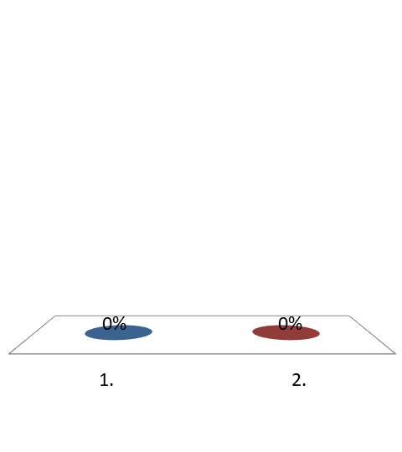
CS must answer all questions forwarded by proponents, 3 days before the EOI closes.
True
False

Slide 106
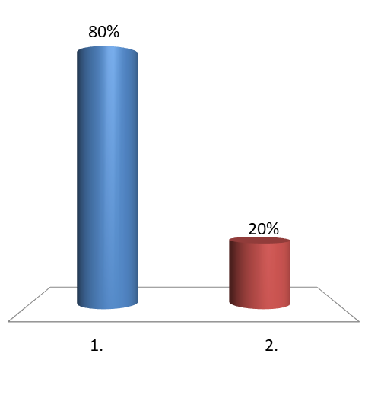
Discussing any risks you perceive in providing services to the government, should lessen potential risks to both parties.
True
False

Slide 107
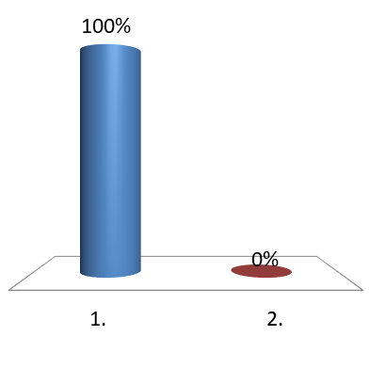
If you have provided the same service to the government before, do you still have to include a detailed description of your experience?
Yes as each procurement evaluation only considers the information contained in this proposal on this specific process.
No, govt will look to those service providers who they have been happy with in the past.

Slide 108
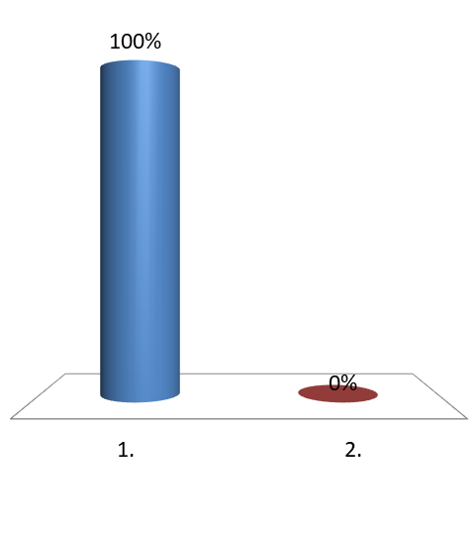
Well framed proposal budgets will result in a more accurate pricing for govt
True
False

Slide 109
Exercise - Top Tip
At your tables
Take a moment to reflect back on the workshop
Come up with one thing that you will take back to your office that will help you write a better proposal
Share with your neighbour

Slide 110

Now go and submit your best proposal!

Slide 111


Top five tips!
1. Read the proposal and answer the ACTUAL questions, not what you think the questions should be.
- embarrassingly simple – so make sure you actually answer the questions asked!
- the format required for a proposal is often redundant, but it is ESSENTIAL to answer format provided or your proposal may be eliminated
2. Don’t “cut and paste” your entire proposal
- Re-use your information intelligently! Think about how experience and past projects can be slightly modified to give you an edge
Eg. resumes, past projects, etc.

Slide 112

Top five tips! …continued…
3. Limit your self-promotion
The brilliance of your proposed solution, your people and your price, will win you the opportunity, not your self-advertising
Limit your self-promotion to the sections where you are explaining your solution
Eg. In the course of XYZ project, our company was able to reduce administration costs by 40% on project XYZ
4. Explicitly explain what you do, to what is being asked for
Connect all the dots for the reader. Never assume that the reader can extrapolate what you is in your proposal, to their problem.
Fully explain in your proposal why you are the right person/team for the opportunity – the easier it is to understand the better.
5. Budget enough time to prepare your proposal
Ensure that you have decided whether the opportunity is worth your while. If it is, devote the appropriate amount of time to preparing.

Slide 113

Thank you from Three E Training.
www.3etraining.ca
kara.thompson@3etraining.ca

