Slide 1
Well-Being and Resiliency
Supporting Safe and Healthy Children and Families
Family and Community Resiliency Division
Alberta Children’s Services
May 2020

Slide 2
Agenda
Well-Being and Resiliency in Children’s Services
About the Well-Being and Resiliency Framework
Family Resource Networks
Next Steps

Slide 3
Children’ Services
Mission:
Outcomes
◆
Families are supported to provide a safe and healthy environment for children and youth.
Children and youth in need of child intervention are supported in order to achieve safety and well-being (including a successful transition to adulthood)
Greater collaboration between government, communities and Indigenous partners strengthens services and achieved shared social outcomes.
Ensure that infants, children and youth are safe and resilient by working together with caregivers, families and communities to develop nurturing and supportive environments.
❖
⬥

Slide 4
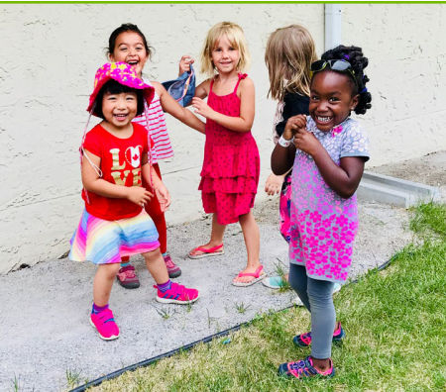
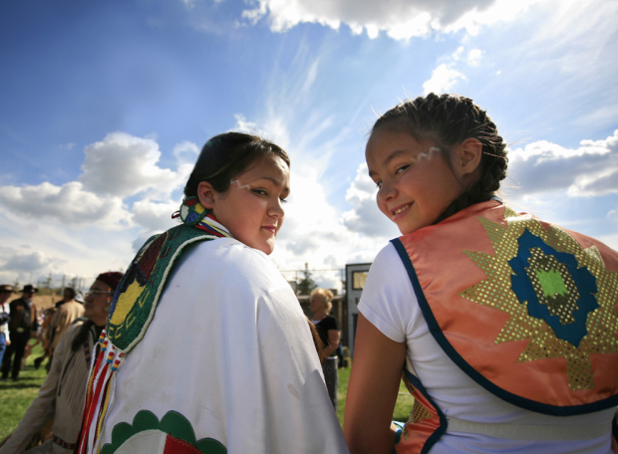
Family and Community Resiliency Division
Mandate:
Oversee initiatives, services and programs that aim to reduce the impacts of early adversity by promoting the development of well-being and resiliency.
Notes:
The Family and Community Resiliency Division is one of the divisions with the Ministry of Children Services.
We work along side the other divisions including Child Intervention and Policy, Innovation and Indigenous Connections.

Slide 5
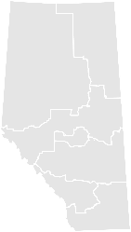
Family and Community Resiliency Division
Supports early childhood development (including child care) and prevention/early intervention programs and services.
Policy Development (strategy)
Service Delivery (operations)
Early Childhood Development Branch
Supports early childhood development (including child care), parenting resources, and prevention/early intervention programs and services to enhance resiliency, reduce risk factors and strengthen protective factors within children, youth and families.
Regional and Community Program Delivery
Regionally based delivery staff across the province provide licensing services to child care programs and prevention and early intervention specialists work with vulnerable Albertans and client serving agencies.
Prevention, Early Intervention and Youth Branch
Develops and implements targeted approaches to promote protective factors and reduce risk factors that lead to children, youth and families becoming involved with Child Intervention.
PIEPM Supports evaluation, statistical monitoring and reporting, as well as quality assurance and continuous improvement activities to ensure programs and services are achieving their intended goals
Notes:
PIEPM – Program Information, Evaluation and Performance Measurement Branch

Slide 6
Our Strategic Approach
A multipronged approach integrating different levels of prevention is needed to effectively address child maltreatment and its root causes.
Universal (Address Root Causes)
Universal
Services that focus on building protective factors and preventing the development of risk factors and vulnerabilities.
All Albertans
All children, youth and families in Alberta
Targeted (Focus on Identified Risk Factors)
Targeted
Focuses on involvement when vulnerabilities are first identified to reduce the need for more intrusive and intensive interventions.
Target the ~50,000 families who are assessed, but no CI file opened.
At Risk
Children, youth and families who are or may become involved with CI.
Intensive (Focus on Child Intervention)
Intensive
Targeted supports and services for children, youth and families experiencing significant adversity, after maltreatment has occurred, to reduce the long-term negative consequences and prevent recurrence.
Intervention
Children, youth
and families
experiencing
adversity
Notes:
The Government of Alberta’s Prevention and Early Intervention (PEI) programs range from child care services and early learning supports through to programs that prevent the need for child intervention services and promote healthy transitions to adulthood.
Access to services that focus on child, youth and family mental well-being and programs that strengthen parenting capacity, youth skills and social connections help to prevent families from requiring more intrusive interventions later.
While only a small percentage of families in the province may require intervention services, many benefit from a variety of prevention and early intervention services.
This provides the opportunity to promote the well-being of infants, children, youth and families and in turn, build individual and familial resilience.

Slide 7
Well-being and resiliency – why does it matter?
In 2017-2018, child intervention staff responded to approximately 55,000 reports of child maltreatment, neglect and/or abuse – approx. 4,600 reports each month.
Of these, 88 percent did not require an open child intervention file.
Positive experiences in the early years create the foundation for strong and healthy children.
Children who have a healthy start in life are more likely to thrive in adulthood.
Today’s youth are tomorrow’s parents.
Offering prevention and early intervention supports throughout the spectrum of involvement with Children’s Services provides significant opportunities to build healthy youth as they transition to adulthood.
Notes:
These statistics demonstrate that the majority of infants, children and youth who come to the attention of the child intervention system do not require intrusive intervention supports. However, their experiences may place them at risk and prevention and early intervention supports may mitigate that risk and build protective factors, resulting in improved safety, well-being and resiliency

Slide 8
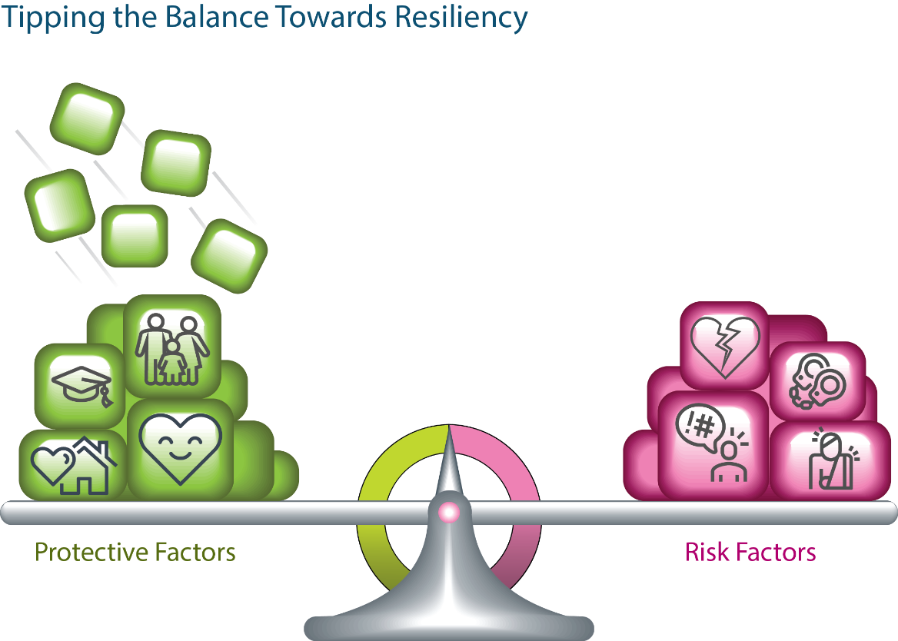
Tipping the balance towards resiliency
Protective factors are positive experiences like attentive caregivers and strong and supportive communities that build personal resiliency.
Resiliency is the ability to maintain or quickly return to a state of well-being, even in the face of significant hardship, adversity or stress.
Risk factors are negative experiences that can cause toxic stress and tip the scale of well-being in a negative direction.
Notes:
Most of us know of people who seem to thrive in spite of difficult childhoods or those who struggle in life even though good caregivers and strong communities loaded their scales with predominantly positive experiences.
Experiences are only part of the story; genes also play a role. A person’s genetic inheritance can be thought of like a fulcrum or the balance point, of a scale.
Some people are born highly sensitive to the effects of toxic stress, while others can withstand significant amounts of stress without experiencing lasting harm to brain architecture.
On the scale, the fulcrum’s position affects how much leverage positive or negative experiences have in shaping life outcomes.
Research shows that people who experience adversity early in life are more likely to experience poor outcomes in learning, relationships and physical and mental health—but this isn’t true for everyone who experiences early adversity.
These individuals are said to be resilient, since they have a positive outcome in the face of negative circumstances.
It is important to note that while genetics will influence the placement of the fulcrum, children are not born resilient, rather resilience is built over time through ongoing positive interactions with caring and supportive adults.
Additional definitions and explanations
FULCRUM (Appendix D )
The point against which a lever is placed/a thing that plays a central or essential role in an activity, event or situation.
A person’s genetic inheritance is like the starting position of the fulcrum or the balance point, of the scale: some of us are born highly sensitive to the effects of toxic stress, while others can withstand significant amounts of stress without experiencing lasting harm to brain architecture.
On the scale, we see that the position of the fulcrum affects how much leverage positive or negative experiences have in shaping our life outcomes
What are Protective Factors?
Used as the basis for the development of the core service delivery domains.
are conditions that increase the health and well-being of infants, children, youth and families
Protect/Shield against or mitigate the impacts of adversity, abuse or neglect.
There are 5 protective factors that are outlined by the Center for the Study of Social Policy (CSSP) and are further described in the Well-being and Resiliency Framework. (https://cssp.org/wp-content/uploads/2018/08/ProtectiveFactorsActionSheets.pdf)
These include:
Parental Resilience
how parents respond to stressors is much more important than the stressor itself in determining the outcomes for themselves and their children.
Parents are more likely to achieve healthy, favorable outcomes if they are resilient.
Resilience is the process of managing stress and functioning well even when faced with challenges, adversity and trauma.
Social Connections
the availability and quality of social connections are important considerations in the lives of parents.
Parents’ constructive and supportive social connections—that is, relationships with family members, friends, neighbors, co-workers, community members and service providers— are valuable resources
These social connections help buffer parents from stressors and support nurturing parenting behaviors that promote secure attachments in young children.
Knowledge of Parenting and Child Development
An understanding of parenting strategies and child development helps parents understand what to expect and how to provide what children need during each developmental phase. All parents, and those who work with children, can benefit from increasing their knowledge and understanding of child development,
Access to Concrete Supports in Times of Need
There are times when parents need access to concrete support and services that address their needs and help to minimize the stress caused by very difficult challenges and adversity.
Parents need experiences that enable them to understand their rights in accessing services, gain knowledge of relevant services and learn how to navigate through service systems
Social and Emotional Competence of Children
The course of social-emotional development—whether healthy or unhealthy—depends on the quality of nurturing attachment and stimulation that a child experiences
Developing brains need attuned, emotionally available parents and other primary caregivers who recognize and consistently respond to the needs of young children, and interact with them in an affectionate, sensitive and nurturing manner.
Such care gives rise to the development of a secure attachment between the child and the adult.
Young children with secure attachments develop a sense of trust, feel safe, gain self-confidence and are able to explore their environments because they feel they have a secure base.

Slide 9
Why the Well-Being and Resiliency Framework?
Notes:
Page #8
The Well-Being and Resiliency Framework builds upon the former Prevention and Early Intervention Framework for Children, Youth and Families (2012) by capturing emerging research and leading practices and reflecting the cultural diversity of our province.
Emerging research and leading practices (Page # 16)
An elevated understanding of infant mental health, the importance of developmental screening beginning in infancy and the need to intervene early when a developmental risk is identified;
The science of brain development, which has illuminated the critical role of responsive, nurturing caregivers, the interplay of biology and the environment in shaping brain architecture and the windows of opportunity that exist in early childhood and again in adolescence;
A deeper understanding of how adverse childhood experiences can impact development and affect health and overall functioning into adulthood;
A growing appreciation among service providers who work with infants, children and youth who have experienced abuse and/or neglect that safety, permanence (belonging) and well-being are inextricably linked and require a shared focus;
The recognition that every responsive and supportive interaction between a caregiver and an infant, child or youth has the potential to positively alter their developmental trajectory and improve their health and well-being; and
A deeper appreciation of the impact of historical trauma on Indigenous families and communities and a renewed emphasis on integrating an Indigenous lens throughout the entirety of our
Reflecting the cultural diversity of our province.
The Framework also incorporates
Indigenous perspectives on wellbeing and resiliency and offers an interconnected perspective by sharing insights about how well-being and resiliency are promoted from both western and Indigenous world-views
New Canadian perspectives
With the growing number of new Canadians settling in Alberta through immigration and refugee programs. The Government of Alberta’s support to individuals, families and communities needs to reflect the unique experiences of new Canadians, the perspectives of diverse cultural, linguistic and religious groups and be responsive to trauma that refugee families, in particular, may have experienced in or after fleeing their countries of origin.

Slide 10
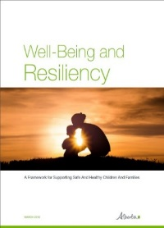
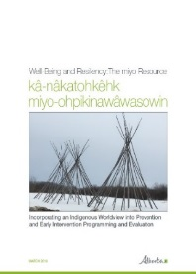
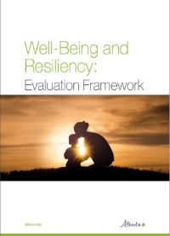
Background
Alberta’s approach to well-being and resiliency is informed by three complementary documents:
1. the Well-Being and Resiliency Framework;
2. kâ-nâkatohkêhk miyo-ohpikinawâwasowin (miyo)
Resource; and
3. the Well-Being and Resiliency Evaluation Framework.
Notes:
Page #8 - These documents work together and build on one another to define and implement Alberta’s approach for service delivery staff and agency partners.

Slide 11
1. Well-Being and Resiliency Framework
Provides rationale for and describes the ways of working to promote well-being and resiliency in Children’s Services.
Defines the key elements of the prevention continuum of services, identifies desired outcomes, supports decision-making regarding funding and service delivery and promotes an understanding of how trauma impacts development.
Notes:
Well-Being and Resiliency Framework (Page#8)
The Well-Being and Resiliency Framework focuses on improving child development and well-being among infants, children, youth and families.
The framework captures emerging research and leading practices and reflects the cultural diversity of our province.
It also incorporates Indigenous perspectives on well-being and resiliency, based on the understanding that western held prevention strategies are not an appropriate or effective approach when working with Indigenous communities.

Slide 12
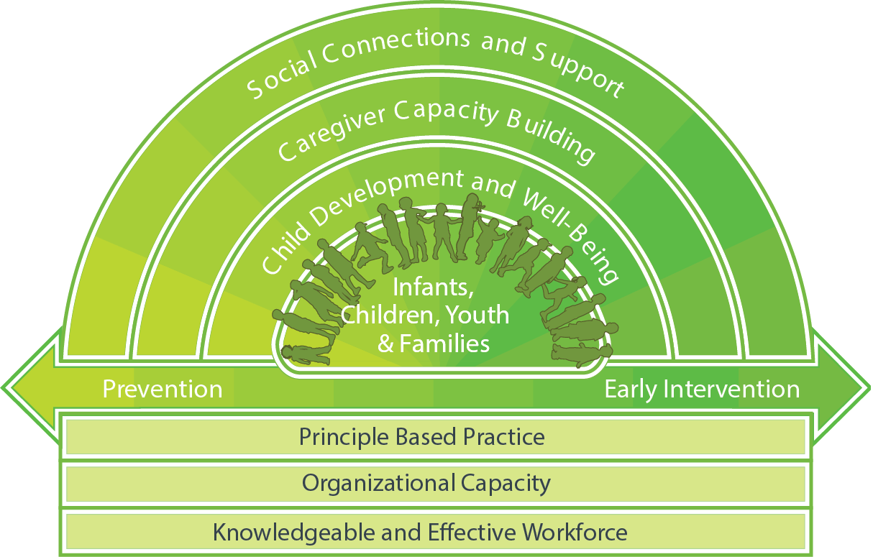
Understanding the Well-Being and Resiliency Model
Core Service Delivery Domains
(three-layered umbrella of support)
Continuum of programming
Foundations for effective program delivery
Notes:
The Well-being and resiliency model consists of three key components:
An umbrella of support – offered through prevention and early intervention programs funded by the government that contribute to strengthening protective factors.
A continuum of programming – that promotes equity for Albertans.
A strong foundation of services – critical to supporting effective program delivery.

Slide 13
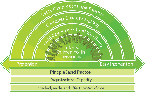
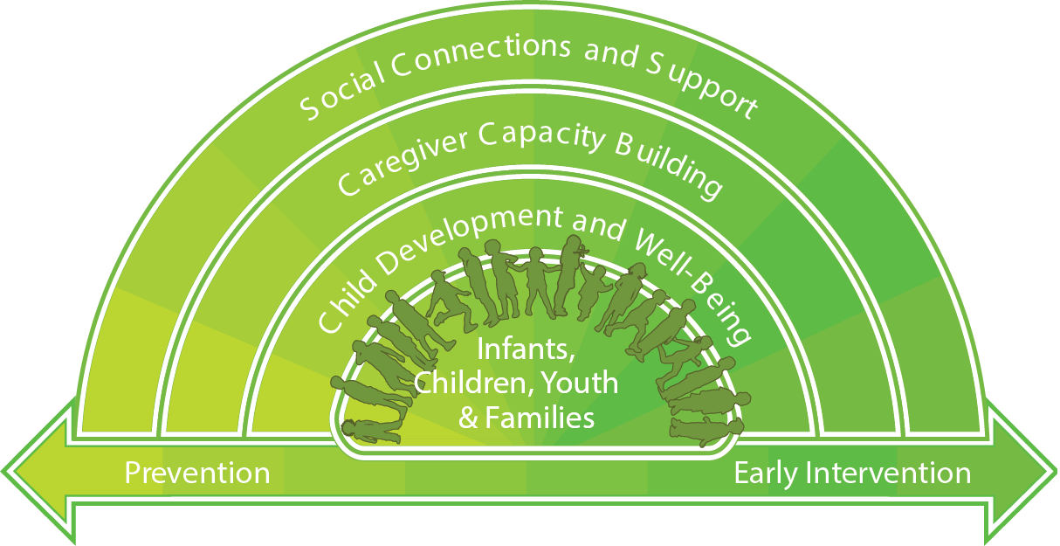
Core Service Delivery Domains (three-layered umbrella of support)
Social Connections and Supports
Activities that promote positive connections between Infants,
children, youth, parents, families, caregivers and
communities.
Caregiver Capacity Building
Activities that promote the development and strengthening of
caregivers’ parenting skills and knowledge - enables
caregivers to create safe, responsive and nurturing
environments and supports healthy child
development.
Child Development and Well-Being
Activities that promote a child’s social, physical,
emotional, cognitive and spiritual well-being in
order to assist the child to reach their
developmental potential.
Notes:
An umbrella of support (Page #18)
The model identifies three umbrellas of support that promote well-being and resiliency.
Social Connections and Supports
Caregiver Capacity Building
Child Development and Well-Being.
Services provided under the Social Connections and Supports Umbrella are strengthened when individuals and families have access to support in times of need and in times of celebration. Friends, family members, neighbours and others who offer and provide emotional support and assistance to parents help build social connections that can reduce isolation (a consistent risk factor in child abuse and neglect). When caregivers are able to identify and access resources in the community during times of need, this may help prevent the stress that sometimes precipitates child maltreatment. This may also help to prevent the unintended neglect that may occur when families lack necessary resources such as food, clothing and housing or essential services such as health care, substance use support services and mental health services.
Services provided under the Caregiver Capacity Building Umbrella are intended to increase both knowledge of parenting and child development and parental resilience. When parents and caregivers are emotionally resilient, they are able to maintain a positive attitude, creatively solve problems and successfully overcome challenges in their lives. Caregivers who understand child development and positively guide their children’s behaviour are more likely to nurture their children’s healthy development. Accurate information about raising children supports caregivers to have developmentally appropriate expectations and knowledge of positive guidance techniques.
Services provided under the Child Development and Well-Being Umbrella are intended to focus on increasing the social and emotional development of children, which is one of the protective factors described by the (Centre for the Study of Social Policy) CSSP. Interventions that focus on the social-emotional development of children help to mitigate the effects of negative experiences in ways that lead to improved cognitive and social-emotional outcomes. Children who present with challenging behaviours are at greater risk for maltreatment. When children have the ability to interact positively with others and communicate their emotions effectively, this has a positive impact on the interaction between a child and their caregiver.

Slide 14
The Connections
Core Service Delivery Domain | Social Connections and Support | Child Development and Well-being | Caregiver Capacity Building
Protective Factor | Ability to Access Support in Times of Need | Child Development and Well-Being | Parental Resilience
 | Social and Cultural Connections |  | Knowledge of Parenting and Child Development
FRN Services | Information, Referral and Coordination | Child Development Services | Family Support Services
 |  |  | Caregiver Education
Notes:
This table demonstrates the connections between each of the protective factors, the prevention and early intervention services and the Core Service Delivery Domains (three-layered umbrella of support). (Figure 4: Umbrella of Support, Protective Factors & Services (PG. 21).
Each of the Support Umbrellas/Domains of Service are directly connected to one of the five protective factors described by the (Centre for the Study of Social Policy).
Quick Notes re: Protective Factors (Reference Purposes)
Parental resilience: Managing stress and functioning well when faced with challenges, adversity and trauma
Social connections: Positive relationships that provide emotional, informational, instrumental and spiritual support
Knowledge of parenting and child development: Understanding child development and parenting strategies that support physical, cognitive, language, social and emotional development
Concrete support in times of need: Access to concrete support and services that address a family’s needs and help minimize stress caused by challenges
Social and emotional competence of children: Family and child interactions that help children develop the ability to communicate clearly, recognize and regulate their emotions and establish and maintain relationships
Each of these Support Umbrellas/Domains of Service are also directly connected to services outlined in the WBR and within the FRN Network. We will discuss these services as part of the FRN and the Hub-and-Spoke model.
You will also notice that the outcomes outlined in the WBR- Evaluation framework could also be aligned to this table.

Slide 15
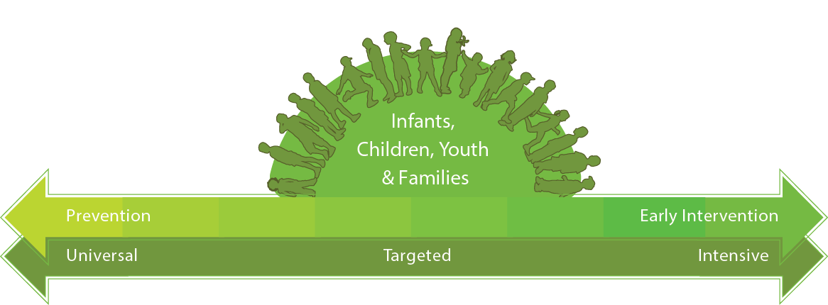
Continuum of programming
A continuum of programming that promotes equity for Albertans and equitable access to universal, targeted and intensive programs.
Universal Programs
All infants, children, youth and families.
Build protective factors and prevent development of risk factors and vulnerabilities.
Targeted Programs
Vulnerable infants, children, youth and families who have risk factors associated with increased risk of child maltreatment.
Strengthen protective factors and reduce the impact of risk factors and the need for more intrusive and intensive interventions.
Intensive Programs
Infants, children, youth and families experiencing significant adversity.
Addresses complex needs resulting from the impact of multiple risk factors, with the intent of reducing long-term consequences of adversity and prevent recurrence.
Notes:
Continuum of programming:
The prevention and early intervention continuum is intended to support stronger outcomes by providing Albertans with equitable access to universal, targeted and intensive programs.
Using the concept of proportionate universality, the Government of Alberta is able to develop programming that is responsive to the needs of all Albertans.
Universal programs
provide the level of support that most Albertans need for infants, children and youth to achieve well-being and resiliency
are designed to reach large portions of the population.
intended to build protective factors and prevent the development of risk factors and vulnerabilities.
are developed to be inclusive;
however, they are not appropriate inaccessible? or not able to meet the needs of some individuals and families who may be experiencing obstacles, challenges or increased risk factors.
Targeted programs
Some Albertans benefit from programs that are targeted to address barriers or the diversity of needs related to risk factors
provided at a higher intensity compared to universal programs.
strengthen protective factors, reduce the impact of risk factors and the need for more intrusive and intensive interventions later on.
Intensive programs – (emphasize the concept of significant adversity and the complexity of the family’s need and the impact of multiple risk factors)
An even smaller percentage of Albertans are not able to access targeted programs as they experience significant obstacles or challenges that are unique to them as an individual or as a family
All individuals and families have strengths; however, risk for child maltreatment increases as the well-being and resiliency of individuals and families are negatively impacted.
At times, these individuals or families may require more intensive supports.

Slide 16
Foundations for effective program delivery
Principles-Based Practice
Guides engagement with infants, children, youth and families to promote and support consistency across policy organizations, programs and practitioners.
Principles:
Organizational Capacity
Government working collaboratively with the agencies it funds to support the capacity for delivering the continuum of services.
Knowledgeable and Effective Workforce
Ensure that services are delivered with the required knowledge, skills, abilities and resources required.
Indigenous experience
Preserve family
Strength-based
Connection
Collaboration
Continuous Improvement
Notes:
The foundational elements illustrated at the bottom of the Well-Being and Resiliency Model describe how services are provided to Albertans. (Page # 23)
Principle-based practice (6 Principles)
is an approach to practice that aligns an organization’s attitudes, behaviours, beliefs and activities to a set of principles defined by a group of people or a guiding document.
informs how we engage with infants, children, youth and families by enhancing consistency across policy organizations, programs and practitioners
Indigenous experience
Indigenous peoples have always had their own ways of ensuring that vulnerable members, including children, are safe, protected and nurtured.
We honour this by recognizing their expertise in matters concerning their children, youth and families.
Preserve family
We believe children and youth should be safe, healthy and live with their families;
we focus on preserving and reuniting families and building on the capacity of extended family and communities to support children, youth and families.
Strength-based
Our approach is reflective, culturally responsive and strength-based.
All families have strengths and resources, we recognize and support the right and responsibility of parents to share in the decision-making process for them and their children.
Connection
Children and youth are supported to maintain relationships that are important to them, to be connected to their own culture, to practice their religious or spiritual beliefs
Collaboration
We are child-focused and family-centred.
We collaborate with families, community agencies and other stakeholders in building positive, respectful partnerships across integrated multidisciplinary teams
provide individualized, flexible and timely services to support these efforts.
Continuous improvement
Our casework is transparent and we share information appropriately.
Our approach is outcome-oriented and evidence-based; therefore,
we support innovative practice, evaluate our performance and strive for continuous improvement.
Organizational capacity
is multi-faceted
continually evolving
encompasses the wide range of capabilities, knowledge, support and resources needed for an organization to be effective.
The Government of Alberta works collaboratively with the agencies it funds to support the capacity of our continuum of services.
Knowledgeable and effective workforce
The strength and efficacy of any service lies in the capacity of its people to provide effective supports to families.
The basis of the service delivery model is the knowledge and skills that exist within the service delivery network to ensure that services incorporate the required knowledge, skills, abilities and resources.

Slide 17
2. kâ-nâkatohkêhk miyo-ohpikinawâwasowin (miyo) Resource
Discusses foundational beliefs and approaches of Indigenous peoples to promote well-being and resiliency.
Outlines an evaluative process that honours an Indigenous worldview.
Recognizes culturally-based practice and assesses program effectiveness and the achievement of outcomes in a meaningful way.
Notes:
MIYO Resource:
The miyo Resource has been developed to incorporate an Indigenous Worldview into the Well-Being and Resiliency Framework. (Pg 8 – MIYO)
discusses the foundational beliefs and approaches of Indigenous peoples to promote well-being and resiliency
outlines an evaluative process that honours an Indigenous worldview.
It is intended to be used by Indigenous organizations or in Indigenous-serving programs. (Pg 8 – MIYO)
Page 21-22
Naquin suggests a model of practice-based evidence that includes three levels based on Indigenous methods and practices of wisdom-seeking.
Level I focuses on 22 Well-Being and Resiliency Framework – The miyo Resource | alberta.ca | March 2019 client-based evidence (satisfaction surveys, comment cards, interviews, etc.).
Level II relies on practice-based evidence (Indigenous expert opinion, articles, awards, Elder interviews, ceremonies etc.)
Level III includes research-driven evidence (journal articles, review panels, participatory research etc.). (See Appendix A)

Slide 18
3. Well-Being and Resiliency Evaluation Framework
Describes the desired results and outlines ways to monitor progress and understand the outcomes.
Includes indicators and measures for the defined continuum of services.
Serves as a platform for ongoing monitoring, adaptation and continuous improvement
Notes:
The WBR Evaluation Framework: (Page #9)
Describes the desired results of the Well-Being and Resiliency Framework
Outlines ways to monitor progress towards and understand meaning of outcomes.
Describes two sets of outcomes (Pg#13-Evaluation Framework)
Individual and family program outcomes describe how certain elements of an individual or family’s life or experience change as a result of participating in a program or receiving a service. These outcomes include:
Children and families are more socially connected and linked to culturally relevant supports
Parents and caregivers have knowledge about parenting and child development
Parents and caregivers are resilient
Children and youth experience healthy social and emotional development
Systems outcomes describe how certain processes have changed as a result of the established goals, elements or principles. These outcomes include:
Services are consistently available, aligned, effective and accountable
Programs are delivered by competent and knowledgeable staff
Programs are culturally safe and inclusive

Slide 19
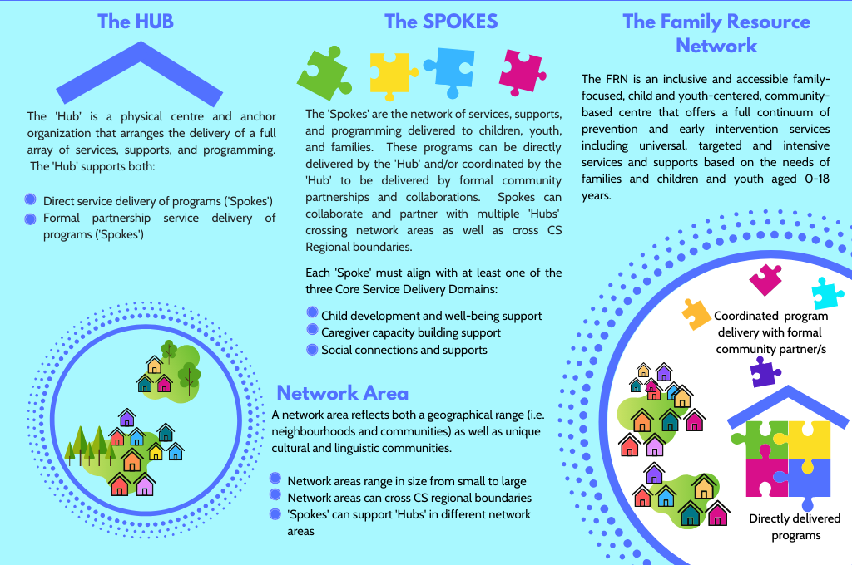
Family Resource Networks (FRNs)
Notes:
FRNs
offers a continuum of prevention and early intervention services including universal, targeted and intensive programs.
respects and reflects the culture, language and spirituality of the people they serve.
Provide supports and services that are available to all children, youth, and families and that ensures that the intensity of services is proportionate and responsive to the degree and level of presenting needs with a focus on Alberta’s most vulnerable infants, children, youth, and families
equitably distributed geographically throughout Alberta with multi-factor considerations including geographic area and communities served, population size and age distribution, cultural and linguistic needs, population vulnerabilities with services contextualized to the unique needs of the local community

Slide 20
The ‘Hub’ – anchor organization
Direct service delivery
Information, Referral & Coordination
Other ‘Spoke’ services
FRN Development
Network Monitoring & Reporting
Notes:
1.Direct Service delivery of Information, Referral and Coordination services. All FRN spokes provide information and referral for the families that they are involved with, sometimes families require additional support to access services and so some FRN services will provide “supported referrals’ - these activities are often built into a number of programs and spokes. However the HUB has a dedicated spoke - a specific services that is intended to support families to access services within the Network and across community. Information, Referral and Coordination services provided by the Hub align with the P,EI continuum with a primary focus on support families at a targeted/intensive level. Hubs across the province have built this spoke based on this concept. Often families need coaching and support in understanding service systems and how to access the services they need. Families with problems with literacy or for whom English is not the first language may need particular help in navigating services.
In addition to providing direct service to families – they are also responsible to develop FRN networks …
Part of this development includes a coordinated referral pathways within and across the FRN.
By developing processes (e.g roles and responsibilities) and strengthening practices. Agencies work together with the ‘Hub’ organization to collaborate and coordinate their support, services, and interventions to children, youth, and families. Partnerships and collaborations are essential components of FRNs.
Ensuring that the elements (domain, age cohorts, continuum) within the WBR service model are accessible and being provided to families within their network (including HV).
The ‘Hub’ has both formal partnerships that provide core services and informal partnerships that may provide supplemental supports to families, children, and youth in their network area.
Given that the Hub is the anchor organizations it also has a “physical” presence within the FRN networks. This presence exists not exclusively to their building/office but it ensure that families and communities within their FRN network also have access to the continuum of FRN services.
10 Key Responsibilities (included for reference)
1. Establish a physical presence (‘brick and mortar’) location in the community.
2. Coordinate the direct service delivery of Referral and Coordination services (‘Spoke’), supporting families to navigate service systems and partner with parents and caregivers in identifying and accessing community resources.
3. Ensure that either through direct service delivery or formal partnership service delivery, the FRN provides Home Visitation services (see definition of Home Visitation under ‘Family Support Services’).
4. Establish a streamlined FRN program referral process for children, youth, and families accessing FRN supports and services.
5. Ensure that direct service delivery and formal partnership service delivery establishes a full continuum of universal, targeted and intensive services for families, children, and youth aged 0-18 years.
6. Ensure service delivery is flexible, responsive, and contextualized to the unique needs of the community and individual users.
7. Establish effective collaborations with clear roles and responsibilities.
8. Monitor and report all ‘Hub-and-Spoke’ activities to Family and Community Resiliency Division. Annual outcome reporting of all FRN activities, including those delivered by the ‘Hub’ organization (direct service delivery) and all supporting organizations providing ‘Spoke’ services in the FRN (formal partnership service delivery).
9. Ensuring that FRN Standards of Practice are implemented, including specific standards relating to Home Visitation programs.
10. Ongoing assessment, quality improvement, and addressing barriers to FRN access.

Slide 21
What do Spokes do?
Provide a service based on 4 general categories
Information, Referral and Coordination
Child Development Services
Family Support Services
Caregiver Education
Collectively contribute to the full continuum of services across all domains and age cohorts
Operate as formal partnerships through grant agreements with Children’s Services
Notes:
Across the province, people / agencies have packaged or bundled these services differently and this may seem confusing. In an effort to provide some consistency in language we will focus on the basic common element, that being that a spoke is a service that is provided to an Albertan. These service categories (identified on the slide) have been essentially defined by what domain or umbrella of support in the service delivery model that they contribute to. Ie, caregiver education contributes to building caregiver capacity, etc.
Just to be clear about terminology lets be sure about what a spoke is not.
A spoke is not a community. A community is both a geographic area and a social unit with shared norms, values, customs, language, and identity. Each community is unique, with support, service, and program needs that must be tailored to its strengths and challenges.
It is not an agency. An agency is a grant holder or a service provider.
It is not a Program. A program is the way to package or deliver a service. Ie. Triple P is a program that provides the service of caregiver education that contributes to the caregiver capacity domain.
Finally, the last bullet refers to formal partnerships which refers specifically to an agency that is a grant recipient and is delivering a ‘Spoke’ service connected to the ‘Hub’. Informal partnerships will also be an integral part of meeting the needs of vulnerable Albertans and FRN’s are encouraged to continue to build and / or maintain relationships and to work collaboratively with these other service providers and stakeholders in your communities.

Slide 22
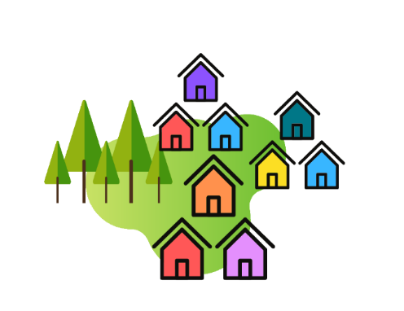
Ongoing Relationships
Early Intervention Specialists
Contract Specialist
Children Services
Communities
Informal Partnerships
Spoke
Service
Providers
Hub Service
Provider
Notes:
FRNs establish inclusive and comprehensive service delivery through direct service delivery and formal community collaborations and partnerships.
Collectively as a group you make up the Family Resource network: the Hub and all the spoke services. Collectively you will serve infants, children, youth (0 – 18) and their families across a continuum of services including Universal, Targeted and Intensive supports, covering three general umbrellas of support – Social Connections and Supports, Caregiver Capacity and Child Development and Well-being.
Other service providers will continue to also support Albertans in your Community. You will of course continue to have ongoing relationships with these service providers as families access needed services from you and them. Some will act as referral sources and some you will refer your families to them.
Your Contract Specialist will continue to work with you on the ongoing monitoring for compliance with the terms of your grant. This will include offering support and direction with payments, financial accountabilities and collecting of reports and other grant requirements.
Early Intervention Specialists have not been available in all parts of the province until now so may be new to you. Their role will be to support partnership development for Networks / communities that could benefit from this support and build their capacity through the facilitation of Communities of Practice. EI specialists will also lead and/or collaborate in the process of the development of Provincial practice standards and outcomes and performance measurement.
While these relationship groups are identified here as separate and distinct, they will all likely be working closely together in implementing and maintaining this FRN initiative. Ie. Contract and EI specialists work closely together in their support of community agencies as well as other partners and stakeholders.

Slide 23
Collaboration Opportunities
Over the upcoming months a number of committees will be established to focus on various tasks and post EOI activities.
Some of these tasks will include:
Development of FRN standards
Outcome reporting and monitoring
Communities of Practice
Notes:
During the EOI process there was a strong element of collaboration encouraged between community service providers. At that time there was also a commitment from GOA that there would be ongoing collaboration with agencies to complete some of the work that will need to be done post EOI., ie development of standards and output and outcome monitoring and reporting. Every agency or individual that submitted a proposal, committed to this work. In order to honor that commitment, the following work teams / committees have been established.
As a part of the governance structure that has been developed to support the implementation of FRN’s across the province, a number of teams have been established to focus on various tasks. Along with staff from various Branches within the FCR Division and from the Contract units, we will be looking for agency representation on each of these teams.

Slide 24
Moving Forward
“We must build the capabilities of adults in order to achieve significant outcomes for the children in their care.”
(Wellbeing and Resiliency Framework)
“Nothing exists outside of relationship.”
(the Miyo Resource)
Notes:
(Page 26 WBR)
By working with prevention and early intervention programs at regional and community levels, government is focusing on continuous improvement and building the capacity of community resources to support families.
This approach is essential to ensure coordinated services that respond to the needs of Albertans, today and into the future.
Flexibility in developing programs that meet the changing needs of families— while maintaining within the context of the communities in which they live, work and play is essential to success.
The Government of Alberta recognizes and values the important work and expertise of community partners and contracted agencies. We look forward to our continued work towards the collective goal of a reduction in child maltreatment and a renewed focus on well-being and resiliency.

Slide 25
Questions ?

Slide 26
More information regarding the Well-being & Resiliency Framework is available at: open.alberta.ca/publications/9781460141939
More information regarding FRNs is available at:
www.alberta.ca/family-resource-networks.aspx

