Slide 1
Roadmap to COR

Slide 2
Presented by: Alberta Association for Safety Partnerships
In Partnership with:
ALIGN
Association of
Community Services

Slide 3
Preamble
There will be 4 sessions at each location designed to introduce participants to the ten elements required by the Partnerships COR Program.
To provide the assistance necessary to create and implement a internal health and safety management system to achieve a Certificate of Recognition

Slide 4
Preamble
Each session is scheduled to last 8 hours.
The first 3 sessions will be the heaviest work load, please be prepared to put forward some serious effort but also know there are people available and willing to assist.

Slide 5
Session One
Part 1:
General Partnerships Info and
Program Outcomes

Slide 6
PARTNERSHIPS PROGRAM
Alberta Labour
Workers’ Compensation
Board
EMPLOYERS
Certifying Partners

Slide 7
Elements of a Health and Safety Program
Management Leadership and Organizational Commitment
Hazard Identification and Assessment
Hazard Control
Ongoing Inspections
Qualifications, Orientation and Training

Slide 8
Elements of a Health and Safety Program
Emergency Response
Incident Investigation
OHSMS Administration
Joint Work Site Health and Safety Committee an/or Health and Safety Representative
Contractor Management

Slide 9
Session One
Part 2:
Management Commitment and Leadership

Slide 10
Management Commitment and Leadership
There must be commitment by the senior
management for the program to succeed
Assignment and awareness of health and safety roles, responsibilities at all levels of the organization (senior management, middle management, employees, volunteers
Commitment to the program from all levels
OHS Act – Section 2.1 Obligations of employers, workers etc.

Slide 11
Management Leadership and Commitment
Experience has shown that lack of
management commitment is the largest single reason for the failure of a health and safety program, second is lack of (employee) worker involvement.

Slide 12
Session One
Hazard Identification and Assessment

Slide 13
Hazard Identification and Assessment
Identification of jobs and operations
Identification of hazards associated with the jobs and operations
A mechanism to evaluate hazards according to risk and determine order of importance to implement controls
Review of hazard assessments when changes are made to operations.
OHS Code – Part 2 Section 7 & 8

Slide 14
Session One
Hazard Controls

Slide 15
Hazard Controls
Engineering Controls
Isolation, substitution, ventilation etc.
Administrative Controls
Work instructions, procedures, rules etc.
Personal Protective Equipment
Eye, head, hand, foot etc.
OHS Code Part 2 – Section 9 &10

Slide 16
Session Two
Part 1
Inspections

Slide 17
On-going Inspections
A written policy or procedure
A format for conducting inspections
A system to ensure follow up action for correcting deficiencies
Inspections are a process used by employers to ensure hazards are identified and controls are appropriate and fit for purpose thus meeting the Code requirements.
Noted throughout the Code as a verification

Slide 18
Session Two
Qualifications, Orientation and Training

Slide 19
Qualifications, Orientation and Training
A Worker that is not competent to perform work
that may endanger the worker or others must not perform the work unless under the direct supervision of a competent worker.
An Employer must ensure that a worker is trained in the safe operation of equipment the worker is to operate and other related training as noted in sub-section (2 – 5)
OHS Regulation Part 1 Section 14 &15

Slide 20
Session Two
Emergency Response
Planning

Slide 21
Emergency Response
Employers are required to prepare in writing an emergency response plan for all types of emergencies that may affect their business.
Written plans addressing possible emergencies
A communication system
Training of employees to the plan
Testing of plans to measure effectiveness
OHS Code Part 7 and Part 11

Slide 22
Session Two
Accident/Incident Investigation

Slide 23
Incident Reporting & Investigation
The OHS Act clearly identifies employer
requirements for reporting and investigation of serious injuries and accidents.
The OHS Code outlines the employees responsibility to report all illness and injury to their employer as soon as possible.
Includes corrective actions and follow-up
OHS Act 18 and 19 / OHS Code Part 11

Slide 24
Session Three
OHSMS Administration

Slide 25
Program Administration
The OHS legislation does not mandate
specifically the implementation of an eight element program, however…..
An employer wishing to achieve a COR must implement a health and safety program that meets the Partnerships standard.

Slide 26
Session Three
Joint Work Site Health and Safety Committees and/or Health and Safety Representative

Slide 27
Session Three
Contractor Management

Slide 28
Session Three
Related Information

Slide 29
Related Information Included
7.1 - Road Safety
7.2 - Costing Health and Safety Programs Benefits
7.3 - Health and Safety Programs and Legislation
7.4 - Safety Manuals and Safety Programs
7.5 - Communicating a Health and Safety Program

Slide 30
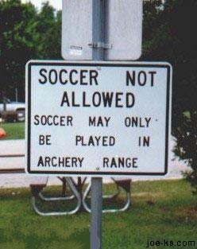
We will strive to make clear communications.

Slide 31
Assignments
There will be work assignments at the end of each session.
The assignments will be reviewed at the beginning of the next session.
The success of Roadmap to COR is dependant on each participant. There must be commitment to the process to succeed.

Slide 32
Session Four
Review and Audit Preparation

Slide 33
Audit Cycle
Year 3
Year 1
Year 2

Slide 34
Achieving and Maintaining COR
To achieve COR - must be External Auditor certified by AASP or your CP of choice.
Maintenance audits in year 2 and 3 – Internal or External (organizations choice)
Internal auditors must be certified (4 days training)
Renewal of COR must be an External Auditor

Slide 35
Achieving COR……
Year 3- Second Maintenance Audit (Internal/External)
Year 1 – Achieve COR - External
Year 2 – First -Maintenance Audit (Internal or External)

Slide 36
Audit Process
Audits involve a three stage process and include:
Documentation Review
Interviews
Observation tours

Slide 37
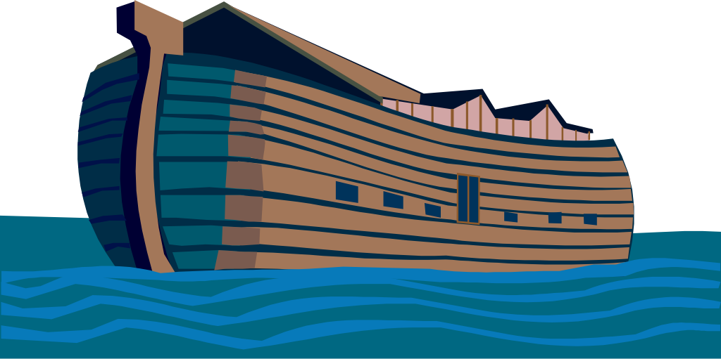
Preparing for Success
"Preparation is everything. Noah did not start building the ark when it was raining."
Warren Buffet

Slide 38
Preparing for Success
We will provide the necessary tools and guidance for each of the organizations to succeed.
Each organization must commit to the process if the objectives of Roadmap to COR are to be achieved.

